Slide 1
Guided Transition to Adobe Experience Manager in the Cloud
© 2021 Adobe. All Rights Reserved

Slide 2

Introducing your Adobe Digital Learning Services instructor
Prasad Kandarpa
Principal Consultant, Adobe Customer Services
2

Slide 3



Introducing your Adobe Digital Learning Services instructor
Anthony Rumsey
Senior Computer Scientist
Migration tools engineering
Over 20 years at Adobe
Enjoy cycling 🚴□and skiing ⛷
3

Slide 4
Key Takeaways
1
2
3
Adobe’s recommended methodology to move to AEM as a Cloud Service
Kick-start your journey to the Cloud with Cloud Acceleration Manager
Tools to help accelerate transition to AEM as a Cloud Service
4

Slide 5
Agenda
Recommended Transition Methodology
Readiness
Best Practices Analyzer
Cloud Acceleration Manager
Implementation
Onboarding to AEM as a Cloud Service
Recommended Steps
Introduction to Cloud Manager
Migration Tools
Best Practice Analyzer & Cloud Acceleration Manager Demo
Helpful Resources
5

Slide 6








Recommended Methodology
Code Refactor
Content Transfer
Readiness
Planning & Setup
Implementation
Go-live
Optimization
Assessment of AEM best practices being followed
High-level migration complexity assessment
AEM as a Cloud Service provisioning
Detailed migration assessment
Project plan creation and resource planning
Get code and project structure ready for AEMaaCS
Move existing content and ACLs to Cloud Service
Code and content freeze periods
Performance and security tests
Cut-over
Continue to modernize code
Optimize content

Slide 7

Readiness

Slide 8


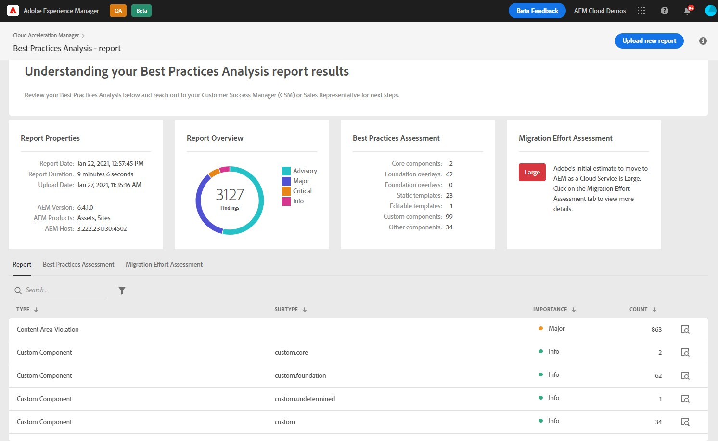

Cloud Acceleration Manager
Kick-Start Your Journey to the Cloud
Benefits of Cloud Acceleration Manager (CAM)
Cloud-first application built on Adobe Experience Cloud
Provides step-by-step guided journey based on Adobe’s recommended methodology
Provides contextual help throughout the journey
Provides best practices for tools and methodology
Reach out to your Adobe rep to get access to your free Cloud Acceleration Manager
application and start your journey today!
8

Slide 9

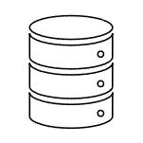


Best Practices Analyzer - Overview
BPA Overview
Using BPA to assess your project
BPA checks an AEM instance against Cloud Service requirements and provides a report that highlights:
Areas that need refactoring
Features in use that are no longer supported
Best-practice recommendations
Self-service / Partner analysis
Existing AEM
customer
Best Practices Analyzer installed and executed on source AEM instance
BPA report used in process of determining AEM CS Transition scope and LOE
Utilizes an updated version of the Pattern Detector with new patterns specific to AEM as a Cloud Service
The BPA report can be a useful input during the process of determining upgrade LOE
9

Slide 10
Best Practices Analyzer – Uses Pattern Detector
Pattern Detector
New Patterns
Analyzes state of AEM repository, using patterns to identify findings of potential or likely backward compatibility issues for planned upgrades
Patterns added to support transition to AEM as a Cloud Service include:
Type | Description
Custom Component (CCOM) | Identifies the usability of Custom Components
Custom template (CTEM) | Identifies the usability of Custom Templates
Custom Client Libraries (CCL) | Custom client libraries and the versions
Findings have a type, subtype, and importance level
INFO – Information only
ADVISORY – Potential upgrade issue
MAJOR – Likely upgrade issue
CRITICAL – Very likely upgrade issue
Execution time may be minutes to over an hour depending on repository size and other factors
Results are cached
Embedded within Best Practices Analyzer install package
10

Slide 11
Best Practices Analyzer – Prerequisites
The Best Practices Analyzer provides an assessment of a current AEM implementation. All the attendees for this training must meet the following prerequisites.
Existing AEM Customers must have a minimum of AEM 6.1 to run the BPA tool. If a customer has an older version of AEM they must upgrade to AEM 6.5 before proceeding with a Cloud Migration
All the attendees must have access to an Adobe IMS Organization
BPA tool execution time may take longer depending on the repository size to generate the report
It is recommended to run the BPA tool on a production clone and come to the training with the exported report
11

Slide 12
Implementation

Slide 13
Onboarding to AEM as a Cloud Service
Before starting the implementation phase verify:
You have an IMS Org provisioned for Adobe Experience Cloud
You have been on-boarded to Cloud Manager
One of the users must be a SysAdmin to manage roles and permissions in the Admin Console
Once you verify all your access, the SysAdmin will be able to create environments after logging in to Cloud Manager

Slide 14
Implementation Phase - Steps
Steps to transition to Cloud Service. These steps may vary for each customer.
Transition Planning Steps | Description
Content Migration to Cloud Service | Use the Content Transfer Tool to help transfer content to an AEM as a Cloud Service instance. Allocate sufficient time for plan and execute the content transfer.
Code refactoring | Review BPA report for recommendations and best practices
Write test scripts | It is a best practice to write unit test cases. Cloud Manager will execute these tests during the build pipeline.
Deploy Code | Setup the Cloud Manager for nonproduction and production pipelines.
Conduct testing | Plan for successful completion of iterative testing.
Milestone – Stabilization Period | Schedule code and content freeze: testing iterations should be complete at this time; this marks the beginning of end-to-end testing for operational readiness.
Cutover preparation | Migrate final content and code.
Run performance and security testing | Plan for successful completion of security and performance testing.
Refresh and rehearse cutover | Perform rehearsal of code and content migration, with the goal of minimizing content freeze duration. Perform end-to-end tests from on-premise environment to one or more Cloud Service environments.

Slide 15
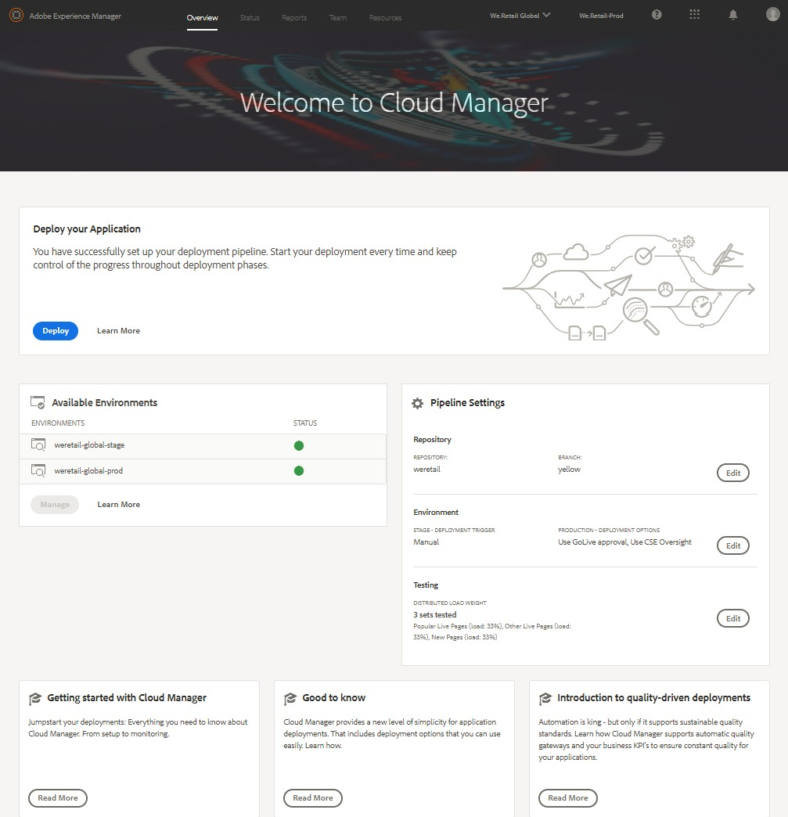
Cloud Manager Overview
Continuous Integration / Continuous Delivery of code to speed time to market for deployment from months/weeks to days/hours
Code Inspection, load testing and security validation based on best practices before
pushing to production to minimize disruptions
Automatic, Scheduled or Manual deployment even outside of business hours for maximum flexibility and control

Slide 16
Migration Tools
Adobe has developed a variety of tools which will help to save time while transitioning to AEM as a Cloud Service.
Cloud Transition Tools
Content Transfer Tool (CTT)
User Mapping Tool
Code Refactoring Tools
Unified Experience Plugin
Repository Modernizer
Index Converter
AEM Dispatcher Converter
Asset Workflow Migration
AEM Modernization Tools

Slide 17


Content Transfer Tool (CTT)
Content Migration can be a complex and time-consuming process, depending on the size of the repository. It is recommended to plan this activity early in the project. CTT is used to move existing content (including users and groups) from a source AEM instance (on-premise or AMS) to the target AEM Cloud Service instance.
Azure Blob Store
Source Instance
Target Instance
AEM Author
AEM Author/Publish
On Prem or AMS
Cloud Service
Extraction
Ingestion
Migration Set
Content Transfer Tool Source AEM

Slide 18
Content Transfer Tool (CTT) – Important Considerations
The minimum system requirements for CTT are AEM 6.3+ and Java 8
If you are on a lower AEM version, you will need to upgrade content repository to AEM 6.5 to use CTT.
The Content Transfer Tool can be used with the following types of data stores
File Data Store, S3 Data Store, Shared S3 Data Store, and Azure Blob Store Data Store
User Mapping - NEW!
The user mapping tool automates the mapping of existing AEM users to IMS
Once configured using CTT this tool will save significant time migrating users to IMS

Slide 19
Content Transfer Tool (CTT) – Migration Approaches
Content Migration is resource intensive activity. It is recommended to allocate enough disk and CPU before stating the tool. There are a couple of approaches that can be adapted to perform the migration.
Cloning the source AEM production Author and Publish and install CTT on these cloned environments.
Run the migration from cloned Author to AEM Cloud Author and cloned publish to AEM Cloud Publish instances. If this method is chosen, then the delta migrations must be performed via AEM packages.
Installing the CTT on Current AEM Production Author and Publish instances. This method supports differential top-up extraction to transfer changes made since the previous content transfer.

Slide 20

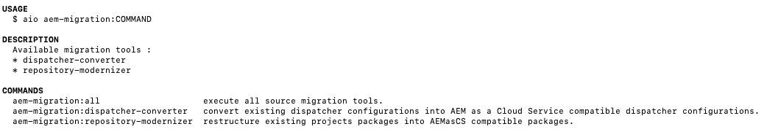
Code Refactoring Tools - Unified Experience
The AEM as a Cloud Service Code Refactoring plugin for the Adobe I/O CLI unifies tools that operate on code and repositories.
Automate code refactoring tasks required to be compatible with AEM as a Cloud Service
Modernize Maven modules
Modernize Dispatcher
Convert Indexes
Reduce complexity associated with installation and setup of code refactoring tools

Slide 21
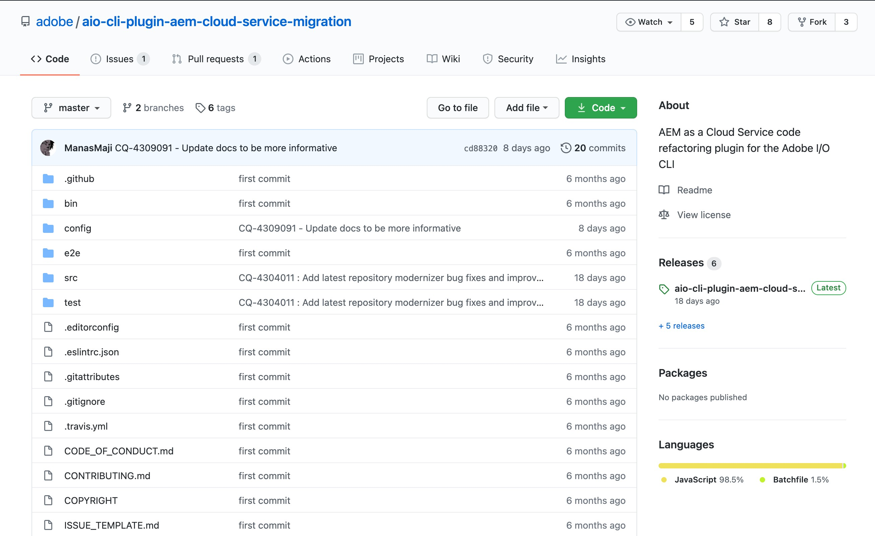
Code Refactoring Tools - Installation
Install aio-cli core libraries
$ npm install -g @adobe/aio-cli
Install AEM cloud service migration plugin
$ npm install -g @adobe/aio-cli-plugin-aem- cloud-service-migration
Link AEM cloud service migration plugin with aio
$ aio plugins:install @adobe/aio-cli-plugin-aem- cloud-service-migration
Verify plugin
$ aio aem-migration --help
https://github.com/adobe/aio-cli-plugin-aem-cloud-service-migration

Slide 22

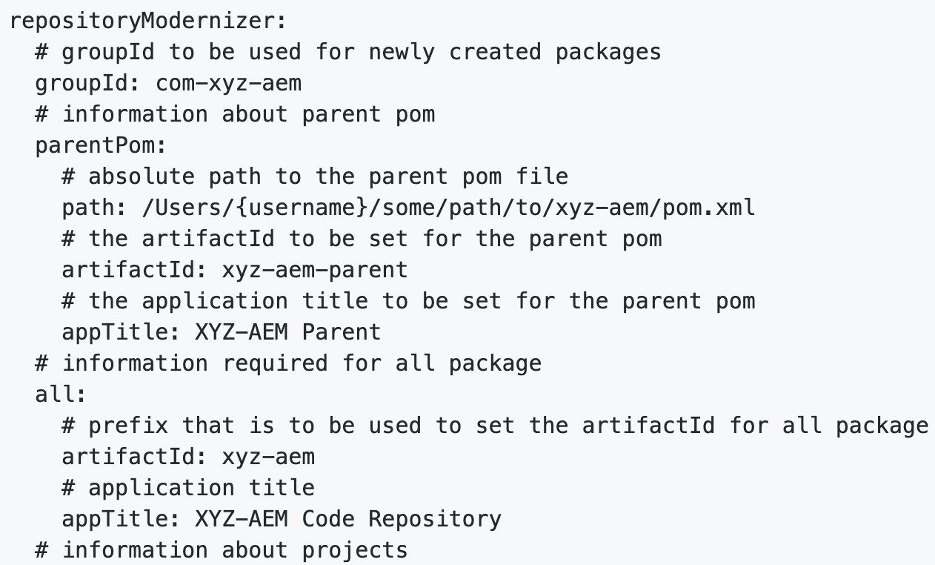
Code Repository Modernizer
$ aio aem-migration:repository-modernizer
Utility developed to restructure existing project packages to be compatible with the project structure required by AEM as a Cloud Service.
Creates a compatible AEM as a Cloud Service project structure by creating the following deployment structure:
ui.apps package deploys to /apps and contains
all the code
ui.content package deploys to runtime-writable
areas (e.g. /content , /conf , /home , or anything not /apps ) and contains all the content and configuration.
all package is a container package that contains the sub-packages ui.apps and ui.content.

Slide 23

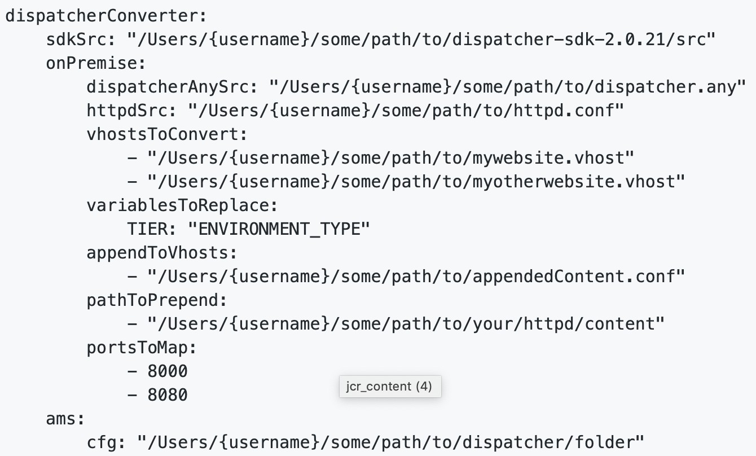
AEM Dispatcher Converter
$ aio aem-migration:dispatcher-converter
AEM Dispatcher Converter was created to migrate existing on-premise or Adobe Managed Services (AMS) dispatcher configurations to an AEM as a Cloud Service compatible dispatcher configuration.
The Dispatcher Converter must be configured before executing. In case of on-premise implementation more specific configuration are required
The nature of AMS Dispatcher Configuration is know it enough to provide the root folder to convert
Choose on-premise or ams for configuration input
$ aio aem-migration:dispatcher-converter -t=ams
Use the dispatcher validator on the converted configurations to validate locally
$ validator dispatcher

Slide 24

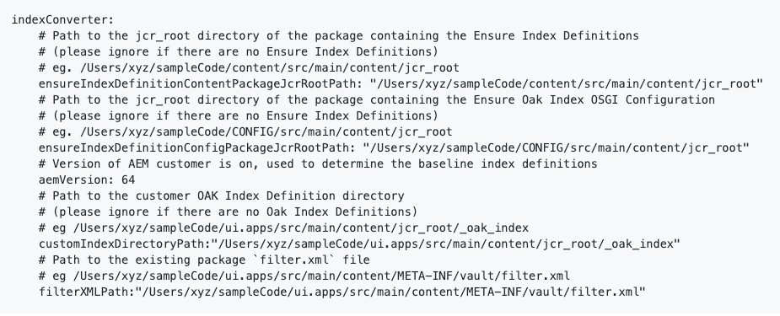
Index Converter
$ aio aem-migration:index-converter
The Index Converter migrates existing Custom Oak Index Defintions into AEM as a Cloud Service compatible Custom Oak Index Defintions. This utility transforms only Lucene type Custom Oak Index Definitions which are present under /apps or /oak:index. It will not transform those Lucene type indexes which are created for 'nt:base’.
AEM as a Cloud Service does not support Ensure Oak Index Definitions, and hence they need to be converted to Oak Index Definitions.
To handle custom OOTB, the tool will compare the two custom OOTB Oak Index Definition to the associated OOTB Index Definition, the difference is merged and created a new custom index definition in AEM cloud. The naming convention used is:
"Name of the OAK Index Definition on AEM as a Cloud Service"- "latest version of this index on AEM as a Cloud Service "-"custom"-1
To handle custom indexes, the tool will validate the indexes against AEM cloud service Oak index, if its valid. The index will be renamed as
"Name of the Custom Oak Index Definition"-"custom"-1 For example, testindex- custom-1

Slide 25
https://github.com/adobe/aem-cloud-migration
Asset Workflow Migration
The workflow migration tool was created to help ease transition from older versions of AEM to AEM as a Cloud Service by automating their transition from a workflow-based asset processing configuration to our new processing-profile based configuration for use with the Asset Compute service.
Download the tool as a complied jar file. The tool will run against the maven project.
java -jar aem-cloud-migration-0.3.0.jar <PATH_TO_MAVEN_PROJECT>
When finished, a report (migration-report.md) will be generated on the changes made
Workflow launchers that are determined in the project to be used for asset processing will be disabled
The script analyzes all workflow models that are referenced by these disabled launchers and automatically generate Processing Profiles for the Asset Compute Service
The tool will edit the workflow models in-place to remove UNSUPPORTED steps and migrate SUPPORTED, REQUIRED
or OPTIONAL. The detailed list can be found in the link below:
- https://github.com/adobe/aem-cloud-migration/blob/master/src/main/resources/workflowSteps.properties
Currently the script is not able to process AND or OR splits. Development team will need to inspect manually and migrate these configurations

Slide 26
Best Practices Analyzer & Cloud Acceleration Manager Demo

Slide 27
Helpful Resources
Documentation
AEM as a Cloud Service release notes: https://experienceleague.adobe.com/docs/experience-manager-cloud- service/release-notes/what-is-new.html?lang=en
Moving to AEM as a Cloud Service: https://experienceleague.adobe.com/docs/experience-manager-cloud- service/moving/home.html
Adobe Tech Blog
https://medium.com/adobetech/tagged/adobe-experience-cloud
To learn more about AEM as a Cloud Service and available tools, please reach out your Adobe representative.
© 2021 Adobe. All Rights Reserved
27
Adobe Digital Learning Services

